Slide 1
Newtonbot
ECE 478/578 Project 2
Team Members:
Kanna Lakshmanan
Lauren Voepel
Jennifer Lara
Rahul Marathe

Slide 2
Project Overview
Part 1: Robot Theatre
Have 3 robots interact verbally in a pre-scripted play
Part 2: Human-Robot Interaction
Our robot should be able to communicate verbally with a human, providing intelligent responses to human prompts

Slide 3
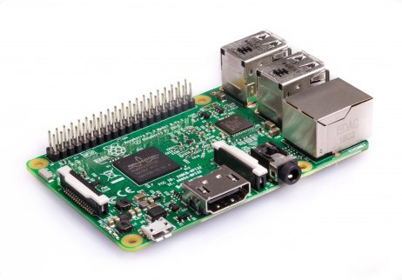
New Hardware
Problems with Intel Joule
Computer would crash when roslanch files were run
Raspberry Pi
Adequate for vocal recognition and output, but unable to use for image processing

Slide 4

Google Dialogflow
Debugging Issues
Service Calls
Virtualbox
Implementation
Use of basic Agent
Integration of Small Talk

Slide 5
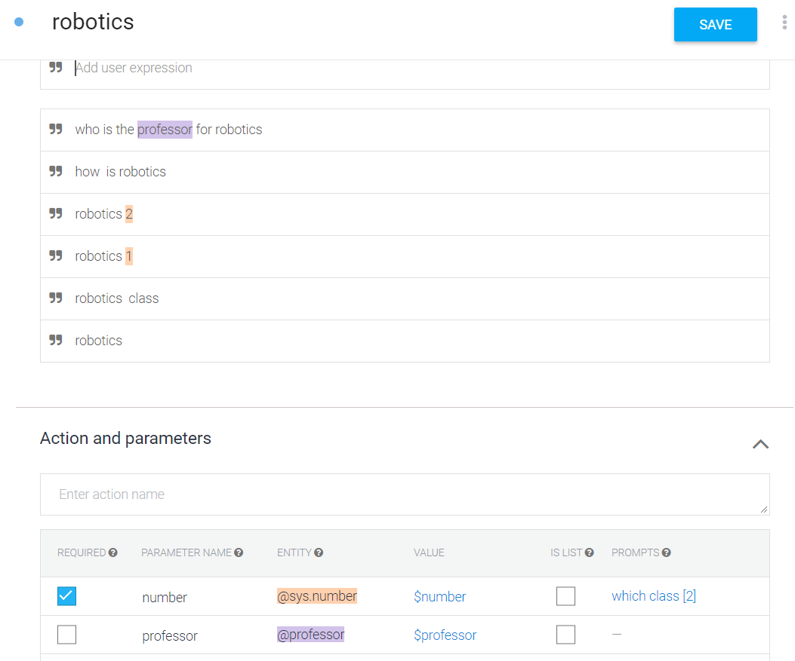
Google Dialogflow
Intents

Slide 6
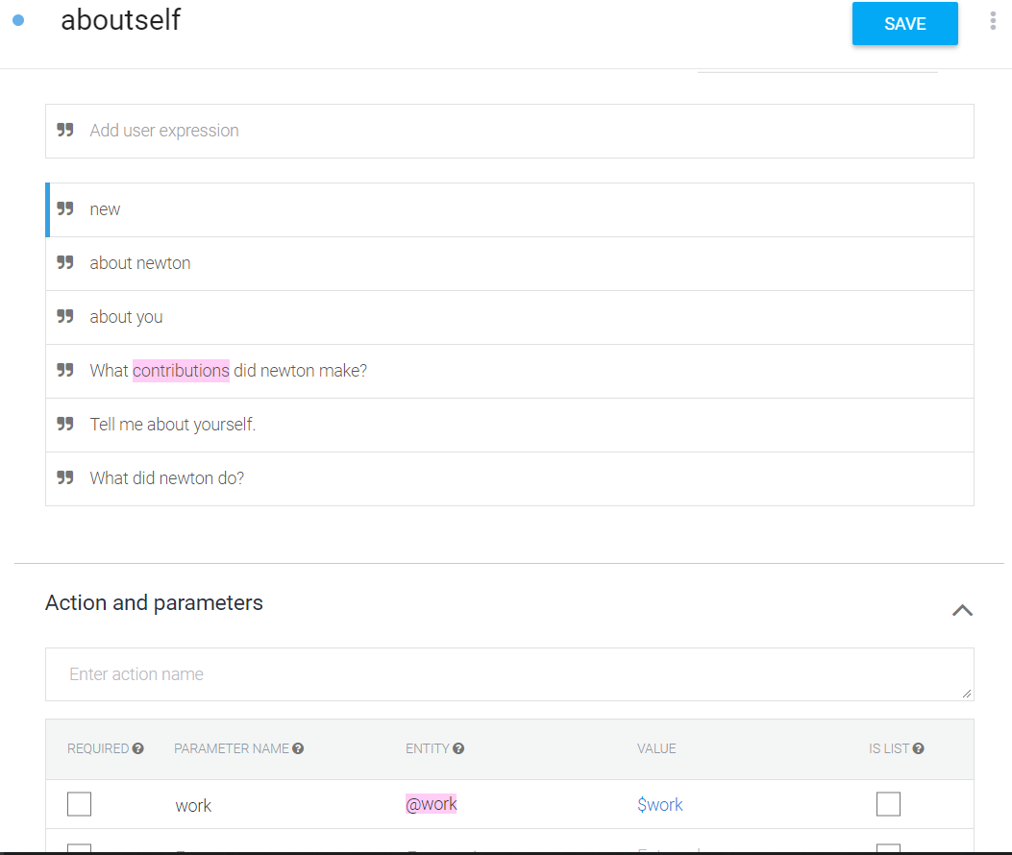
Google Dialogflow
Intents

Slide 7
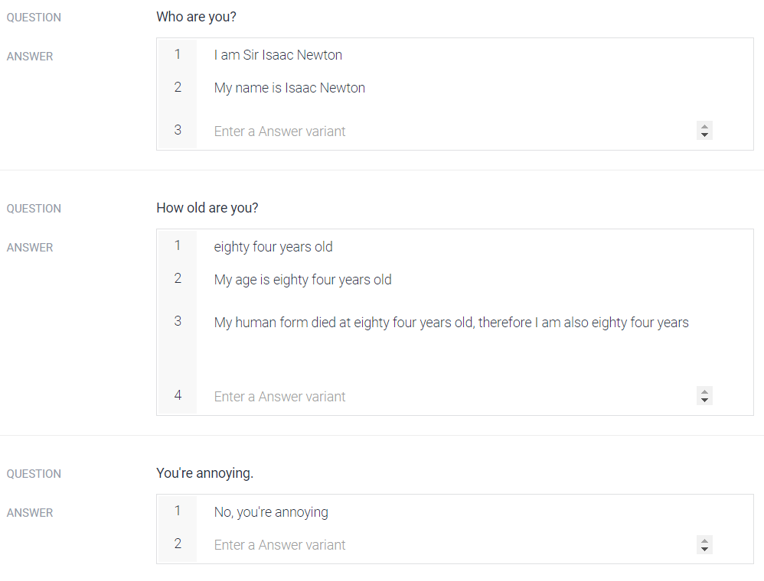
Google Dialogflow
Small talk

Slide 8

Amazon Polly
Speech synthesis software
Takes in text in the form of “Speech Synthesis Markup Language” and outputs vocals
For Newton we used the British-English voice “Brian”

Slide 9
Amazon Polly
Amazon Polly converts input text into life-like speech. You call one of the speech synthesis methods, provide the text you wish to synthesize, select one of the available Text-to-Speech (TTS) voices, and specify an audio output format. Amazon Polly then synthesizes the provided text into a high-quality speech audio stream.
Input text – Provide the text you want to synthesize, and Amazon Polly returns an audio stream. You can provide the input as plain text or in Speech Synthesis Markup Language (SSML) format. With SSML you can control various aspects of speech such as pronunciation, volume, pitch, and speech rate.
Available voices – Amazon Polly provides a portfolio of multiple languages and a variety of voices, including a bilingual voice (for both English and Hindi). For most languages you can select from several different voices, both male and female. You specify the voice ID name when launching the speech synthesis task, and then the service uses this voice to convert the text to speech. Amazon Polly is not a translation service—the synthesized speech is in the language of the text.
Output format – Amazon Polly can deliver the synthesized speech in multiple formats. You can select the audio format that suits your needs. For example, you might request the speech in the MP3 or Ogg Vorbis format to consume in web and mobile applications. Or, you might request the PCM output format for AWS IoT devices and telephony solutions.

Slide 10
Boto 3 Library
Boto3 is the Amazon Web Services (AWS) Software Development Kit (SDK) for Python, which allows Python developers to write software that makes use of services like Amazon S3 and Amazon EC2.
It uses a data-driven approach to generate classes at runtime from JSON description files that are shared between SDKs in various languages. This includes descriptions for a high level, object oriented interface similar to those available in previous versions of Boto.
Because Boto 3 is generated from these shared JSON files, we get fast updates to the latest services and features and a consistent API across services. Community contributions to JSON description files in other SDKs also benefit Boto 3, just as contributions to Boto 3 benefit the other SDKs

Slide 11
Robot Theatre
Interactions between robots
Our robot served as ROS_MASTER to a system of 3 robots
Because lines are pre-scripted they can be stored on robots
Polly lines were stored in a .wav format
Dialogflow was not needed for this section
We’ve included movement for some lines
Turtlebot’s subscribe to the same nodes for moving limbs which makes synchronizing difficult without rewriting preexisting code

Slide 12
Robot Theatre (cont.)
Robots were subscribed to a topic called /lines
If the current line corresponds to a line stored on the robot it plays the line and publishes to increment
Increments only occur after file is done playing
Increment is used by a node called counter which increments lines when it receives increment
Robots all connected to one another using our robot as ROS_MASTER

Slide 13
Human-Robot Interaction
This section requires internet for processing Dialogflow and Polly requests
Interaction process
Voice input -> sent to Dialogflow -> sent to RaspPi -> sent to Polly -> output speech given
Handshaking done via Rosnodes and Rostopics.
Three Rosnodes created for the Interaction:
Dialogflow_speech, Polly_speech and Record_speech
Some conversations were programmed specifically, others utilized Google’s “Smalltalk”feature.

Slide 14
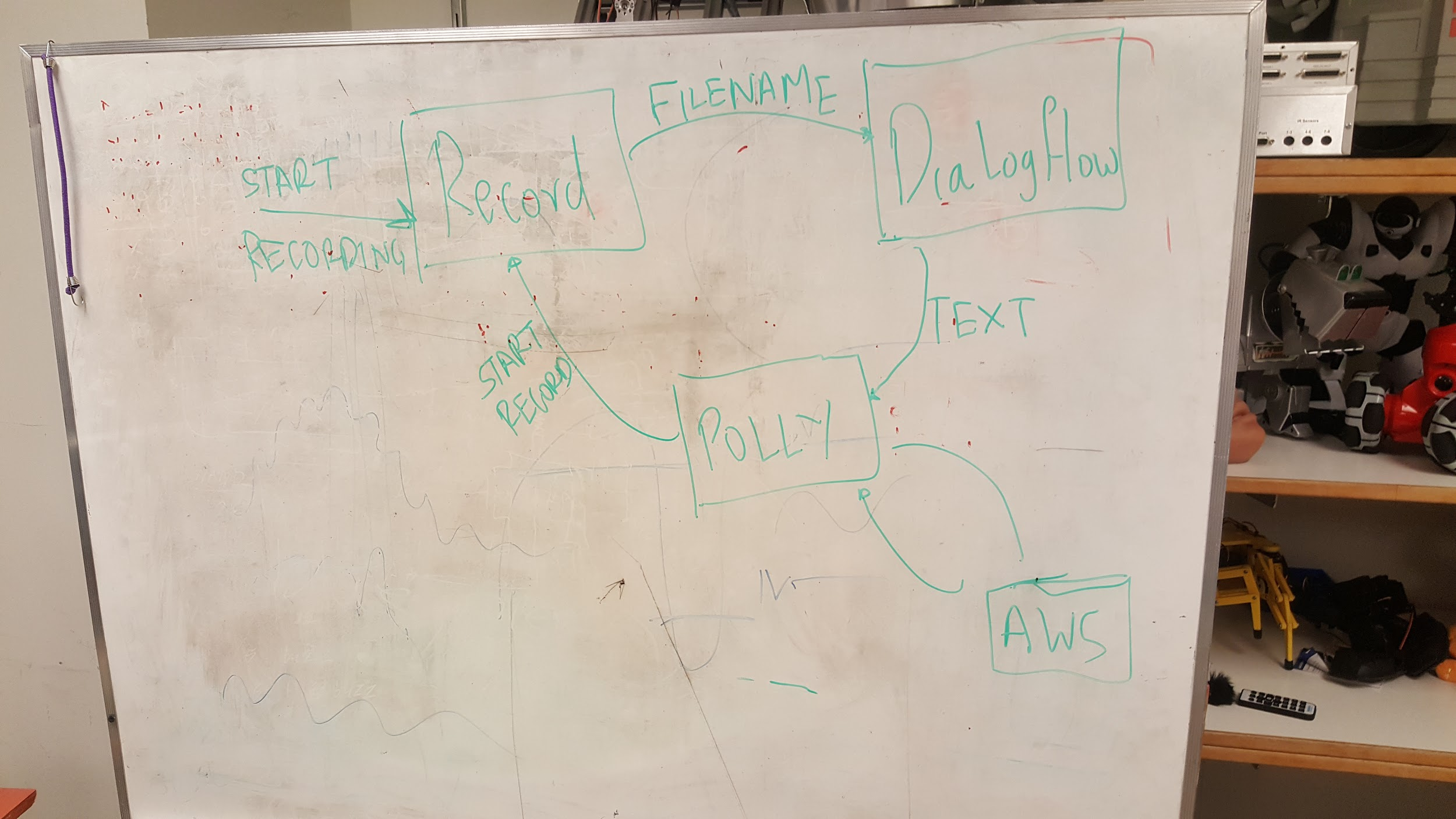

Slide 15
Challenges and Ideas for future Improvements
Camera integration
Refinement of speech synthesis
Movement specifically for robot theatre

